Slide 1

HHH – THE RIDE APP
a Kings of code software package
Tim Haxton (Lead), Cooper wolf, Jon scales

Slide 2

Project overview
Generate app
for the
Hotter’n hell hundred biking event

Slide 3
Impetus for HHH app
Why do we want to do this

Slide 4
Hotter’n Hell Hundred
Largest single day bike ride event in world
Multiple additional cycling events
USAC sanctioned races
~10000 participants
~2500 non-riding accompanying guests
Huge $$ influx for Wichita Falls area businesses
Many sport/recreation-oriented businesses attend

Slide 5
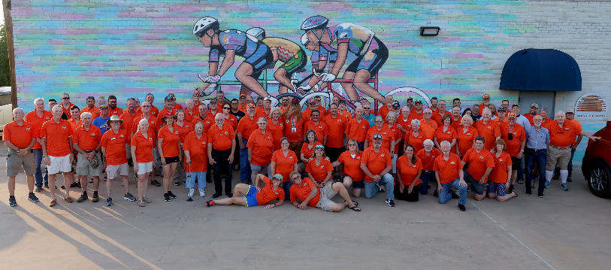
HHH Is a volunteer led event
~100 member steering committee comprised of subcommittees
Well over 1000 volunteers from Wichita Falls and local communities participate
Hotter’n Hell Steering Committee 2024 (image from hh100.org)

Slide 6

HHH web presence

Slide 7


HHH mobile app

Slide 8

Participant registration
~80% of HHH participants pre-register via BikeReg.com

Slide 9
participant registration
~20% of participants register on-site the weekend of the events
Currently a cumbersome process using the BikeReg.com site
HHH Registration Committee needs:
Registration portal with easily accessible, user-friendly, intuitive GUI allowing rapid on-site registration by participants (users)
Intuitive GUI for on-site registration volunteers (admin) to take participant payment and assign rider numbers
Seamless integration of pre-existing BikeReg.com participant database into on-site registrant database
Intuitive interface to allow HHH admin to access participant information in cases of medical or safety emergencies.

Slide 10
Similar Software :
Registration only systems
BikeReg.com (currently used)
Active.com
Apps supporting event registration + additional event functions
SpotMe
Gravel Royale 2025

Slide 11
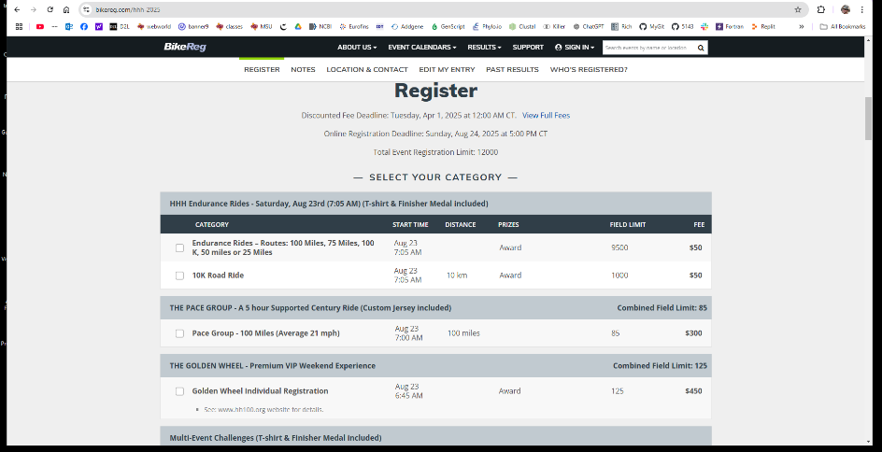
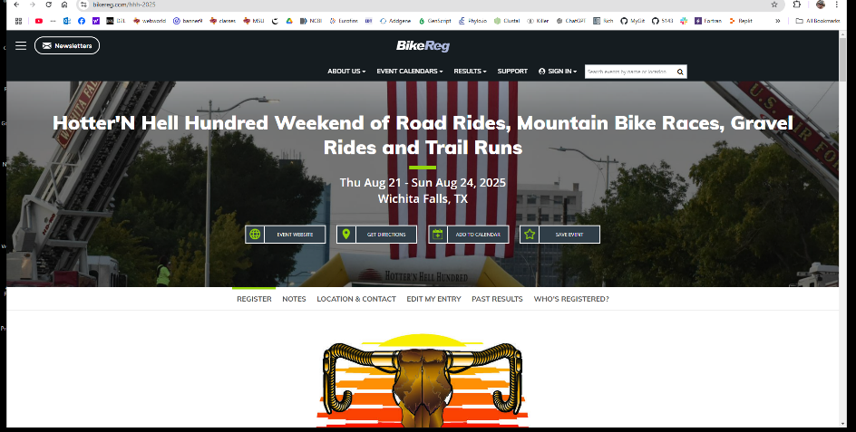
Similar Software : Bikereg.com

Slide 12
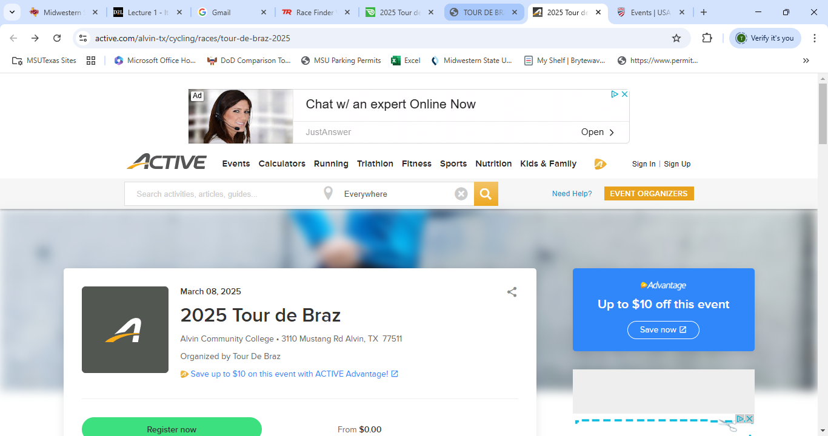
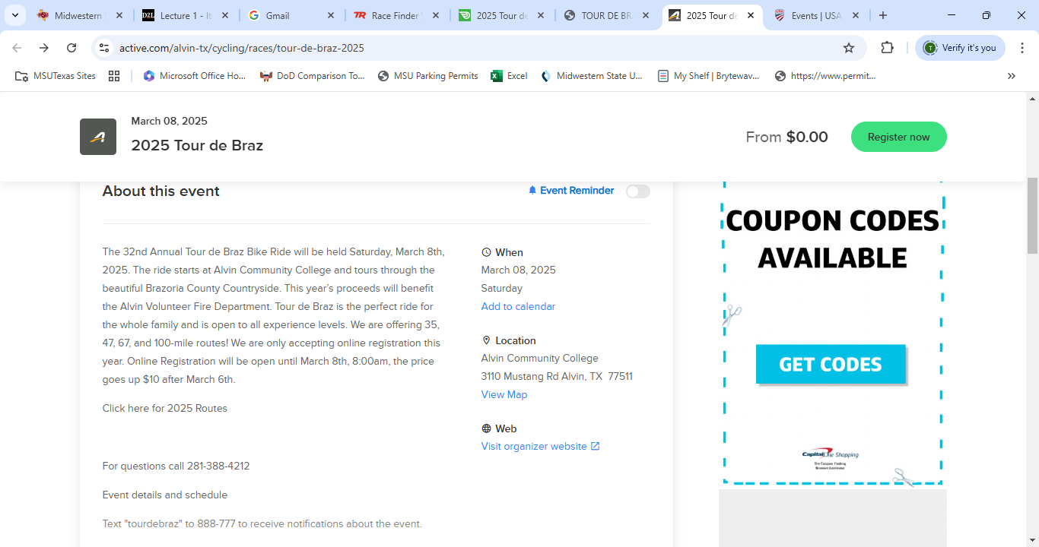
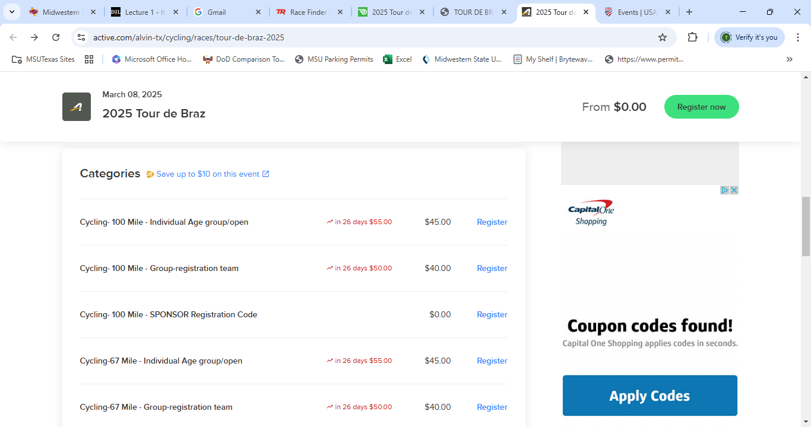
SIMILAR SOFTWARE: Active.com

Slide 13
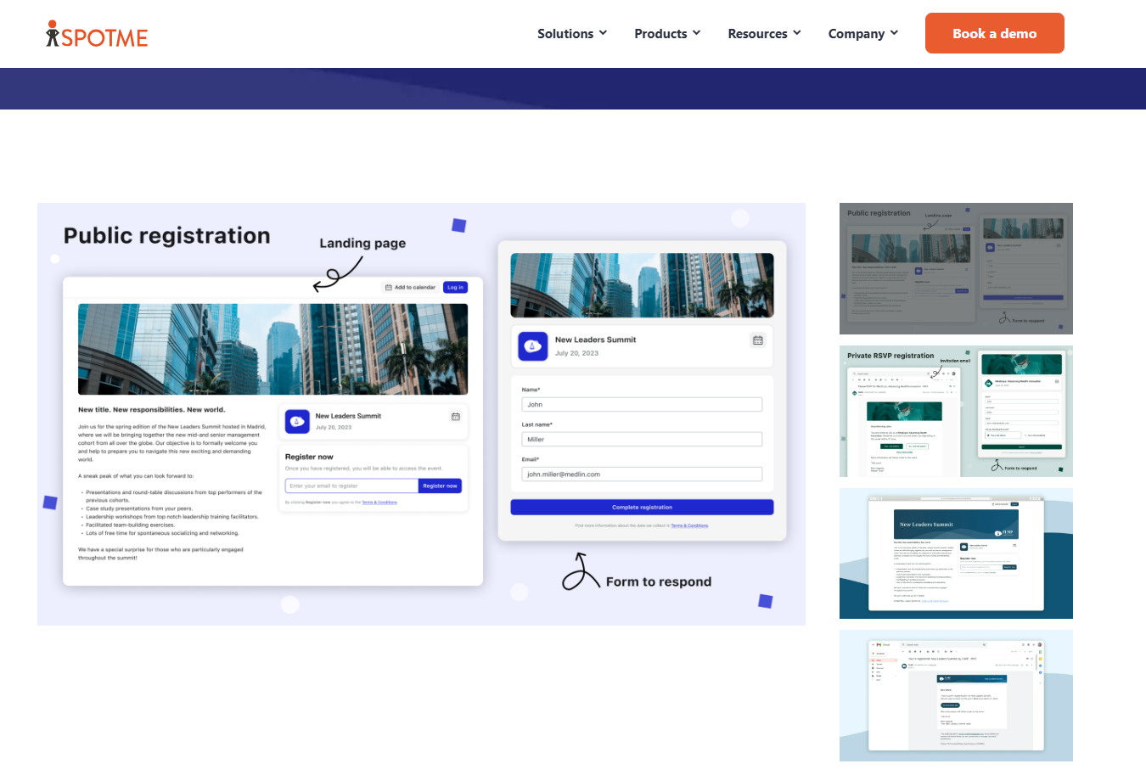
Similar software: spotme app

Slide 14
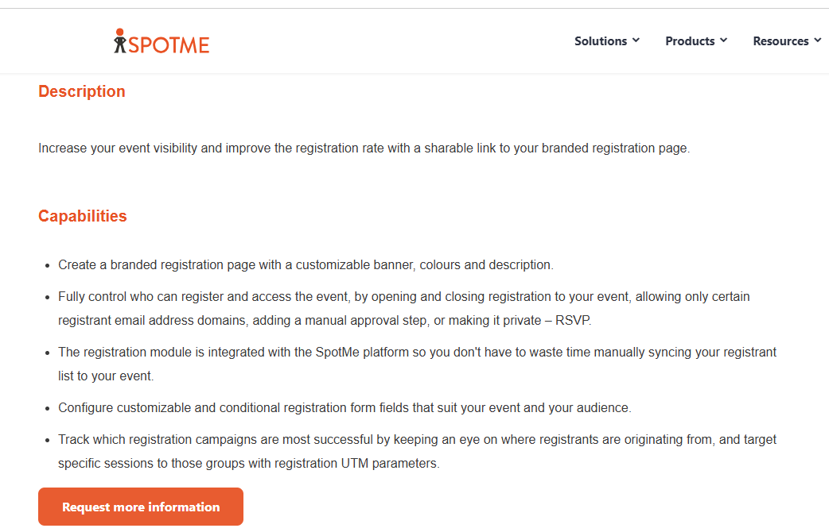
Similar software: spotme app

Slide 15
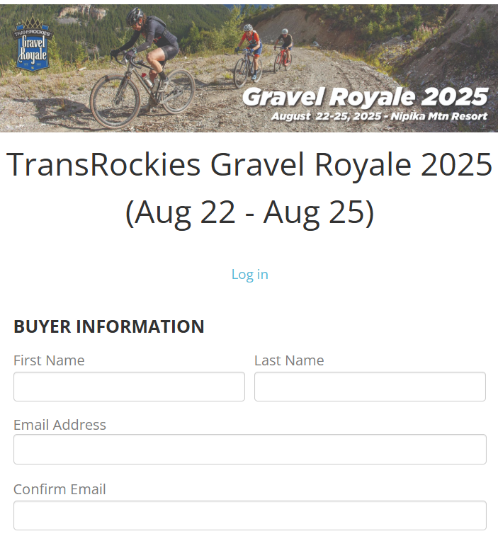
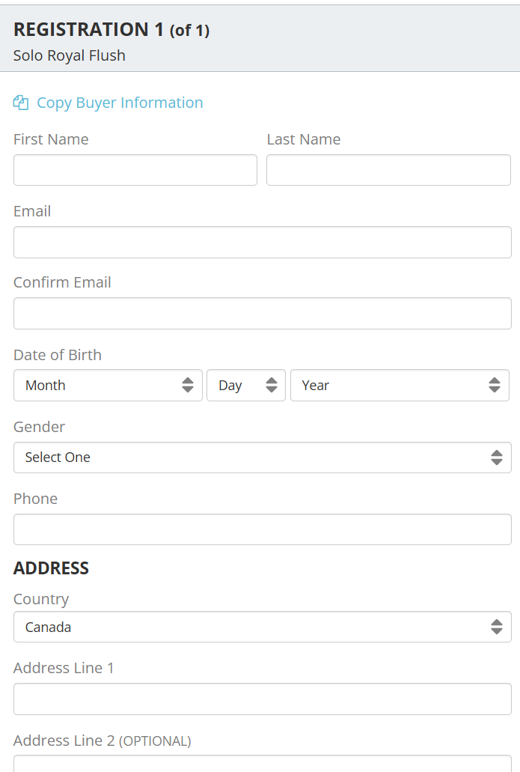
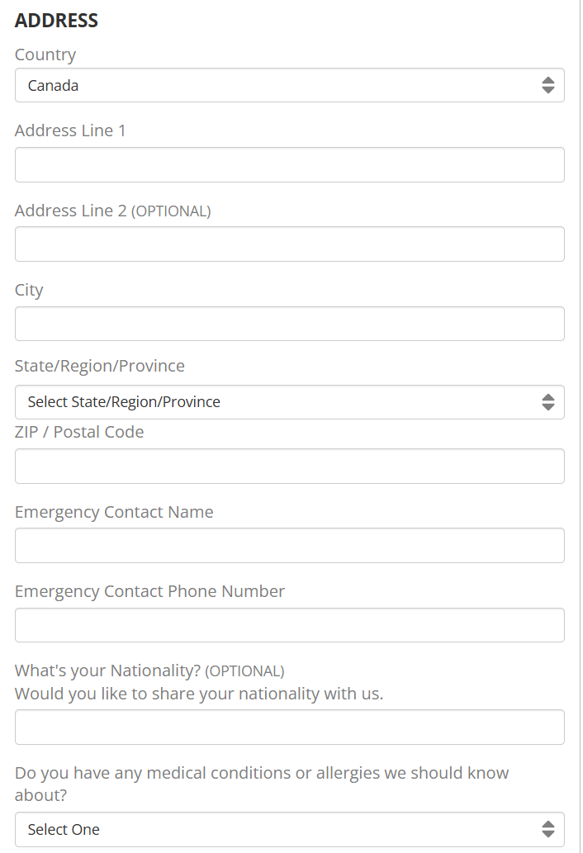
SIMILAR SOFTWARE: transRockies gravel Royale 2025

Slide 16
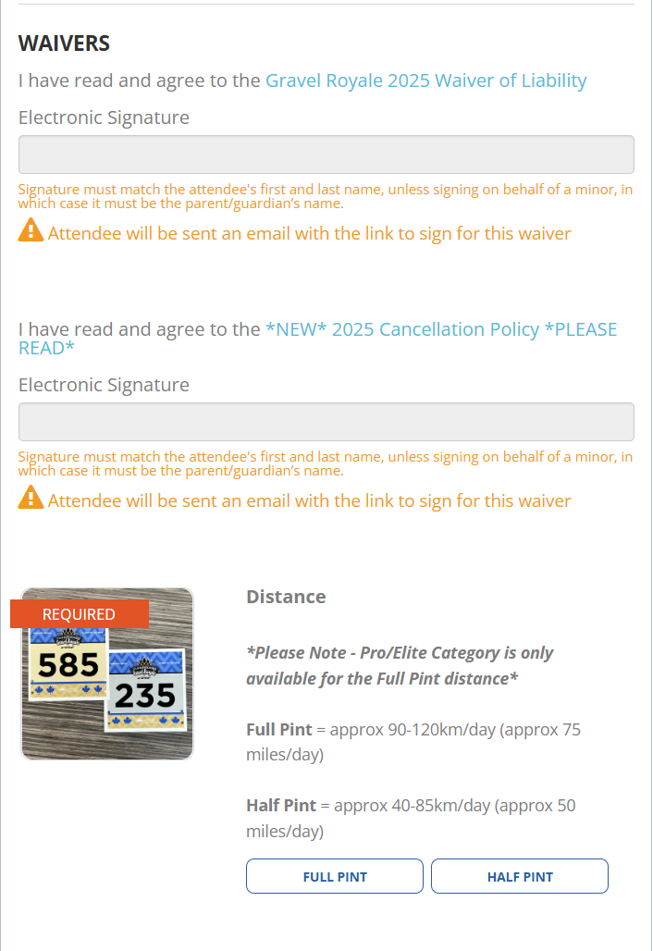
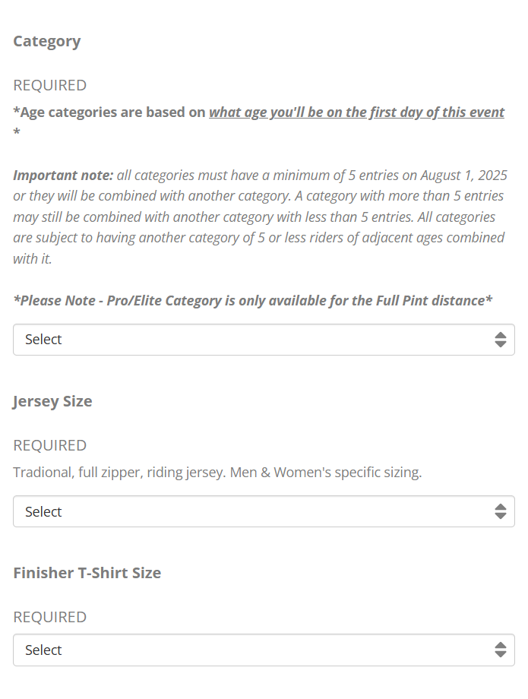
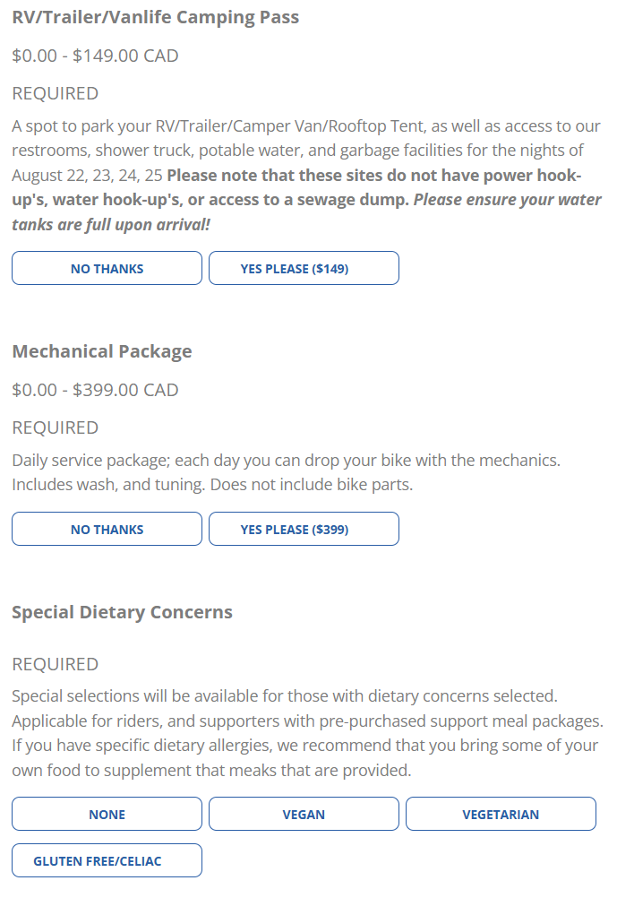
SIMILAR SOFTWARE: transRockies gravel Royale 2025

Slide 17
Desired program features
Streamlined data entry for on site participant registration
Database of participant information accessible by HHH admin
Seamless integration of BikeReg participant database with THE RIDE APP database
At-A-Glance HHH weekend event information for app users

Slide 18
requirements: All USERS
The application shall provide pages for the HHH weekend events schedule & planner
The application shall provide pages for the HHH tradeshow vender list & map
The application shall provide pages for the HHH routes map & tracker
The application shall provide local information guide links to participants
The application shall provide links to HHH social media to participants

Slide 19
requirements: participant side
The application shall allow participants to register for any event on the day of the event
The application shall allow participants to make a SAG assistance request
The application shall restrict participants’ access to HHH-side admin data

Slide 20
requirements: HHH side
The application shall provide access to the on-site registration database
The application shall provide assignment of rider numbers
The application shall provide SAG request response with rider location info
The application shall provide HHH weekend event schedule
The application shall provide tiered levels of administrative access to HHH-side volunteers

Slide 21
CONSTRAINTS:
Frontend restricted to JavaScript, Python, or Django
Backend restricted to C++, Python, or Java
Database restricted to SQL
Application must work on Apple iOS, Android OS, and Windows 11

Slide 22




APP GUI – home
Menu icon hotspot

Slide 23

APP GUI – MENU
ON-SITE REGISTRATION
Home icon hotspot
HHH EVENT SCHEDULES
ROUTE MAPS
TRADESHOW INFO
EATS & DRINKS
SAG

Slide 24

APP GUI – Registration sub menu
REGISTRATION
Previous page icon hotspot
ENDURANCE ROAD RIDE – ANY DISTANCE
10K ROAD RIDE
GRAVA DEL FUEGO – ANY DISTANCE
CHUPACABRA
ROAD RACES
DIRT RACES
TRAIL RUNS

Slide 25

APP GUI – Registration - Endurance
REGISTRATION
First Name
Last Name
Zip Code
Age
E-mail Address
Phone Number
Emer Cont FName
Emer Cont LName
Emer Cont Phone
Emer Cont Relation
Event
Endurance Ride – Any Distance
SUBMIT ENTRY

Slide 26

APP GUI – Registration – Dirt races
REGISTRATION
First Name
Last Name
Gender
Age
E-mail Address
Phone Number
ZIP Code
Emer Cont FName
Emer Cont LName
Emer Cont Phone
Emer Cont Relation
Event
Dirt Races
Category
SUBMIT ENTRY

Slide 27
APP GUI – Registration – SUBMISSION
REGISTRATION
First Name
tadej
Last Name
pogacar
Gender
m
Age
26
E-mail Address
catchme@bike.com
Phone Number
386-30-445-544
ZIP Code OR Country
slovenia
Emer Cont FName
ambu
Emer Cont LName
lance
Emer Cont Phone
911
Emer Cont Relation
doctor
Event
Dirt Races
Category
Cat 1
Submit now active hotspot
SUBMIT ENTRY

Slide 28


APP GUI - waiver
RELEASE FORM
WAIVER OF LIABILIBY

Slide 29
APP GUI – route maps home
ROUTE MAPS
START LINE
100 MILE
100 K
50 MILE
25 MILE
10 K
GRAVA DEL FUEGO

Slide 30
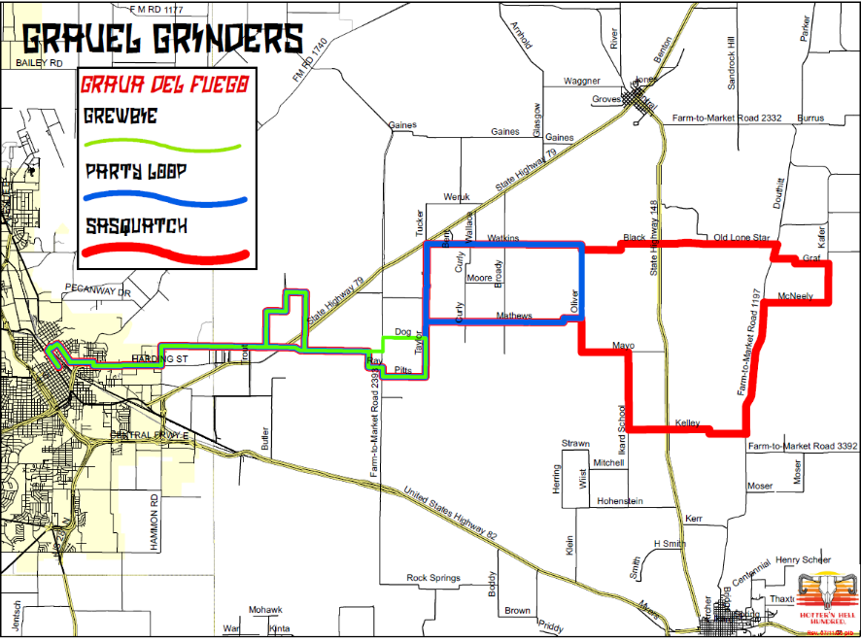
APP GUI – route map
GRAVA DEL FUEGO

Slide 31

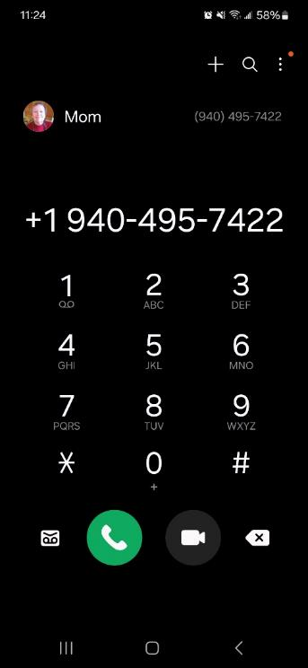
APP GUI – sag request
ON-SITE REGISTRATION
HHH EVENT SCHEDULES
ROUTE MAPS
TRADESHOW INFO
EATS & DRINKS
SAG

Slide 32
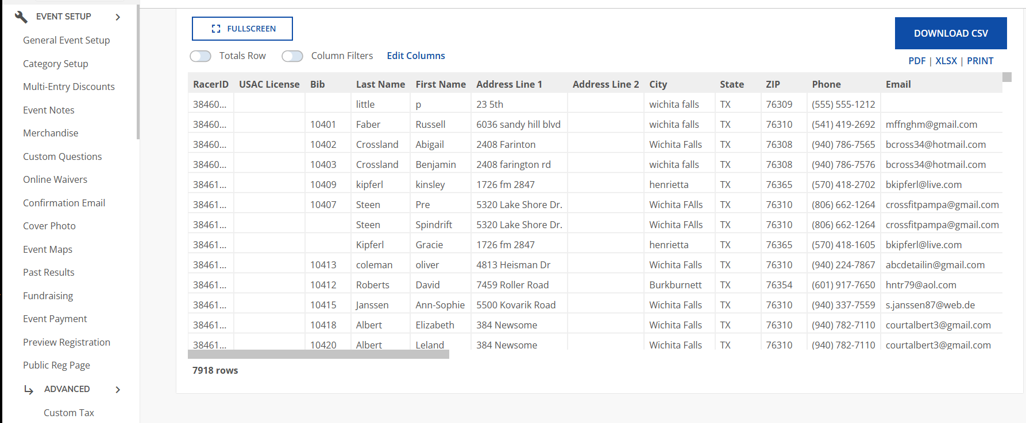
APP – admin side data

Slide 33
development platform
VS Code (Full-Stack development)
Free
Supports JavaScript, Python, and SQL
Works with web, and mobile development

Slide 34
Hardware
Operating Systems
IOS 18+
3GB ram
iPhone X or newer
Android 14+
5GB free space
720p display
Windows 11
>1 GHz processing speed
64 GB storage

Slide 35
Software
GitHub (Version Control)
Frontend
Backend
Data base
JavaScript
Pros: Many frameworks
Cons: JavaScript is more prone to code injections
Python
Pros: Cross-platform development (windows, iOS, android)
Cons: Slower due to it being an interpreted language
SQL
Pros: Easy to learn for beginners
Cons: Not good for analyzing real-time data

Slide 36
Iteration 2
Tim Haxton
Cooper wolf (Lead)
Jon scales
Feasibility study
Technical
Risk
Design Model
SRS
Feasibility study
Legal
Financial
Design Model
SRS
Feasibility study
Resource/Time
Design Model
SRS

